Slide 1
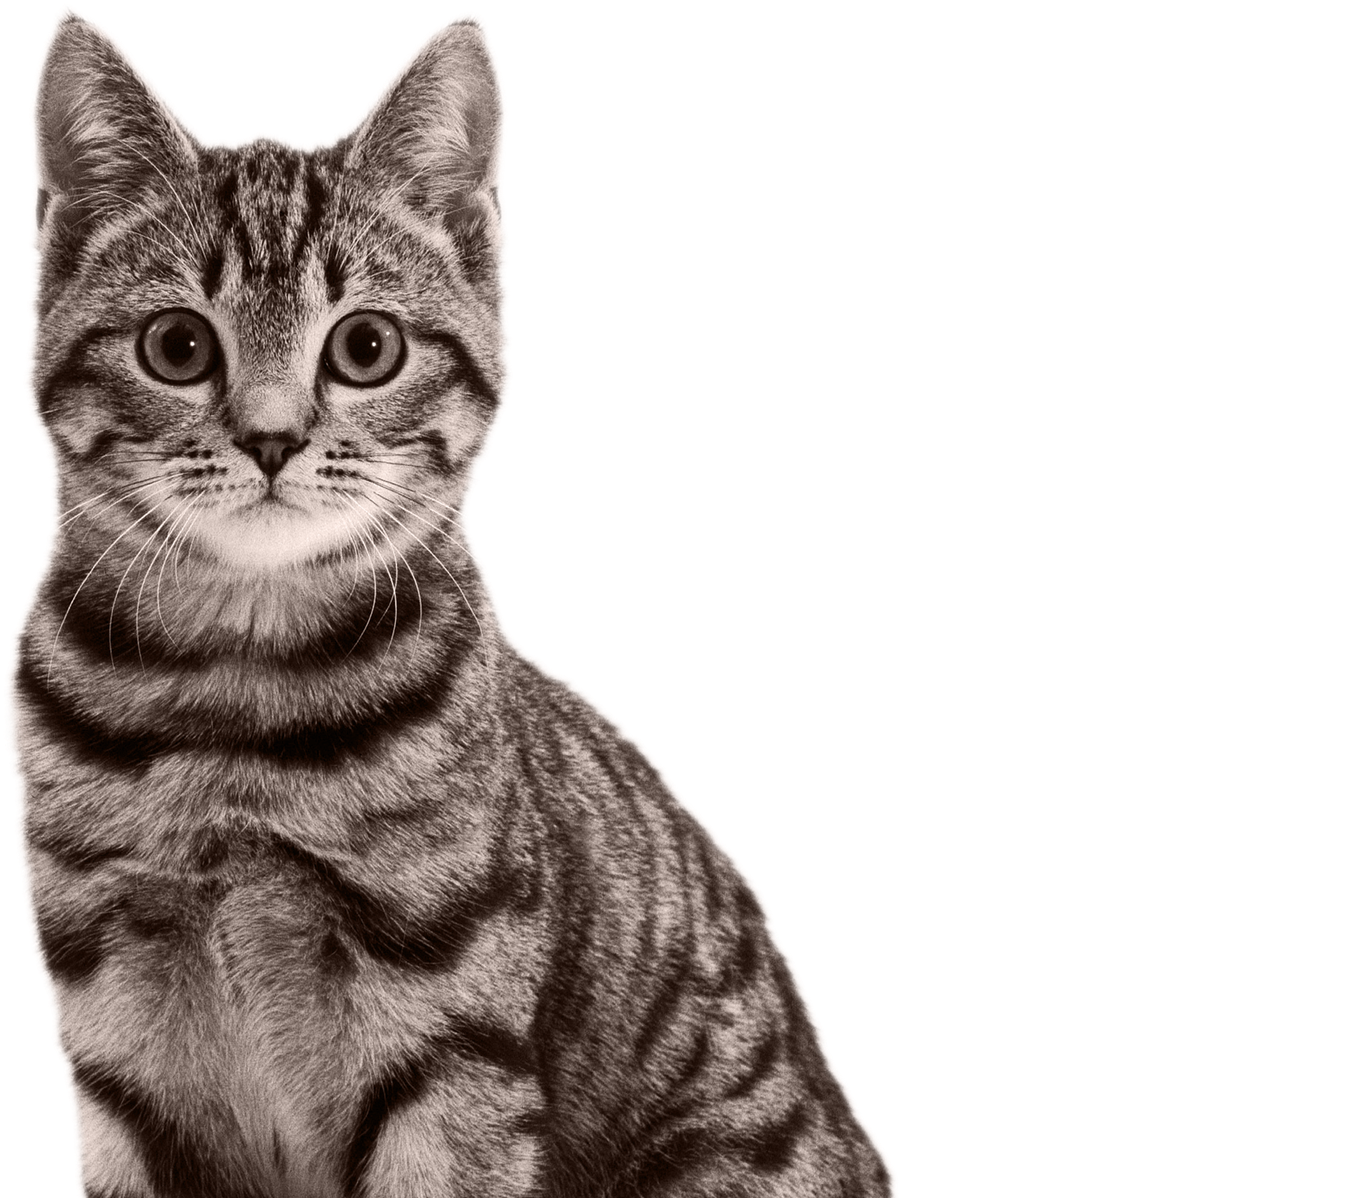


Cats acoustic data Project
Bony Audrey
de Croutte Anne-Victoire
February 4th, 2021
Supervisors : Amandine Schmutz (Mars)
François Husson (Agrocampus Ouest)
Notes:
we are going to show you the work we did during these 2 months on the cat acoustic data project, under the supervision of Amandine from MARS and François Husson from Agrocampus

Slide 2
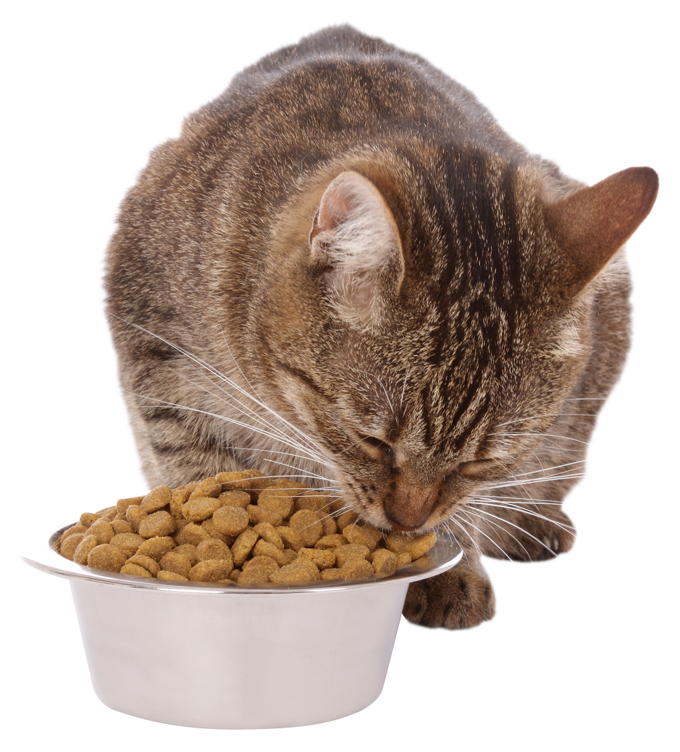
Context
Automation of data acquisition
Task to be digitised: Counting of breaks and bites when cats eat kibbles from video recordings.
Test of an acquisition protocol for event
detection
Notes:
Mars
Automatisation des acquisitions de données Tâche à digitaliser : Comptage des crocs et mastications lors de la consummation de friandises. Aujourd’hui à partir d’enregistrement vidéo
Test d’un protocole de detection d’événements, données acquises par un micro porter par les chats
What was the goal of this project?
To automate a data collection process
Which data ? Cats eating kibbles are observed, and the aim is to know how many times the cat breaks and chews the kibble, for further analysis on kibble effect on teeth, or quality, etc
Task we want to digitize is this breaks and bites counting, because currently they are collected by people watch video recordings, and it’s highly time consuming and quite expensive
So the idea is to try a new acquisition protocol using sound recordings for event detection instead of videos
Image : https://www.pinterest.fr/pin/568931365426236282/ (Verlina)

Slide 3
Issues
Does the data acquisition method allow enough data quality for event counting ?
Does audio data allow the detection of this kind of events?
Notes:
MARS gave us these new audio data and the first question was -> does the acquisition method used allow enough data quality for event counting? So are they usable?
And this leads to another issue which is : does audio data allow the detection of this kind of events?

Slide 4
Overview
I – Usability of Mars data
II – Event counting from audio recordings
Notes:
We tried to answer these questions during our project and we’ll talk first about the usability of the MARS data, and protocol quality
And secondly we’ll talk about event counting process from audio recordings, so which method we developed to count the events

Slide 5
I. Usability of Mars data
A. Data presentation
A cat eats a kibble
Experiment info's
Recording
Responses
Cat name
Diet
Kibble
Session
Amplitude values
25 seconds x 44,1kHz
=
1,1 million variables
Number of breaks
Number of bites
Notes:
Structure des données :
Partie signalétique / Partie enregistrement / Partie labellisation (faible)

Slide 6
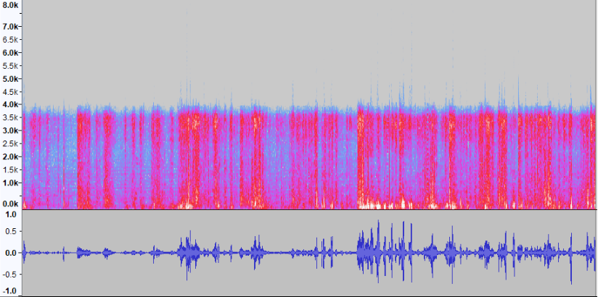

I. B. Visualisation
Record 32
1 break
23 bites
Spectrogram STFT
Oscillogram
(Amplitude curve)
Notes:
Deux representations possible :
Amplitude
Spectro stf (explication de comment c’est construit)
Son associé à ces graph
Mise en parallèle des labellisations faibles
Problème on arrive pas à l’oeil ou à l’oreille à lier les labellisations -> pré-traitement des données nécessaires

Slide 7
I. C. Processing
METHOD
Filtering frequencies
Independant Component Analysis
Does not allow automation
Reducing noise
Protocol has to be modify (several microphones)
Predicting with a weak label *
Does not work on noisy data
Functional data Analysis
* weak label : here labels synthesise an information about breaks and bites events but does not characterise them precisely
Notes:
Fréquences :
Il n’y a pas de fréquence caractéristique du croc
Problème : les bruits recouvrent des bandes très larges
ICA :
Idée : méthode de détection des sources
Problème : Il faut plusieurs enregistrement d’un même moment (ne s’applique à notre protocole) . Bien expliquer que le son doit provenir de plusieurs sources (chat = source, voix = source …)
Analyse fonctionnelle :
Idée : Courbes d’amplitude sont considéré comme des fonctions, extraction d’une variable réponse quanti à partir d’une courbe
Problème : Très mauvaise prédiction
A propos du bruit :
A la main : le processus va être fastidieux et ne donnera pas forcément de résultat (mastication jamais repéré à l’oreille, croc sur certains enregistrements où on les entendait déjà)
Avec ICA : Il faudra plusieurs micro (donc potentiellement plus d’interférences et plus de données à traiter)
A propos de la labellisation :
Induit l’utilisation de méthode particulière pour le traitement (Analyse données fonctionnelle), méthode qui ne fonctionne pas sur les données bruitées.
Ne permet pas de vérifier avec certitude l’efficacité des traitements
Conclusion :
Processing en vue de nettoyer les données (ICA et frequence filtering) pas applicable dans le cadre du protocol
Méthode permettant prédiction à partir de labellisation faible (Analyse fonctionnelle) ne fonctionne pas sur ces données
Point à modifier :
Bruit ambiant (trop présent) évitable (discussion, chat porte micros)
Labélisation faible implique des méthodes très particulières pour résoudre le problème

Slide 8
II. Counting events A. Creation of a new data set
PROTOCOL
Take a video (with a phone) of the cat while it’s eating a kibble around 30 cm far from the head
7 cats
3 types of kibbles
79 recordings
Less Noise
Video and audio
Non-standard duration
Varying collection conditions (distance, way of filming, recording gear, environment, etc.)
Notes:
Since MARS data were too noisy for usual sound treatment methods and since we didn’t manage to clean the data, we decided to create a new data set, trying a new acquisition protocol
The protocol was to take a video of a cat eating a kibble around 30 cm far from the head. We asked friends an family and got 7 cats taking part in the experiment, and we chose 3 sorts of kibbles, 2 from MARS, and one from another brand. With these éléments, we finally got 79 recordings, so with video and sound. We asked to have these both informations to make easier the labelling.
This method has pros and cons. A good thing is that there far less noise, so we can clearly hear the breaks and chews. And the other positive aspect is what I just said about having both infos: video and sound.
But there are some negative points : the duraton of the recordings is not standardized, so it’s more difficult to manage the data as a complete dataset. Furthermore, because we asked friends and family, the collection conditions were very diversified, like the distance to the cat, the way of filming, the recording gear, the environments, and other things
What is interesting is that these cons are things that could be avoided by MARS if the protocol is used
Récolte de données de bonnes qualité (au niveau du bruit)
Protocole
Jeu de données de travail
Point faible :
Variabilité des conditions de la collecte des données (pas les mm salle, pas la même distance, manière de filmer …)
Durée non standardisée
Matériel non standard
AV

Slide 9
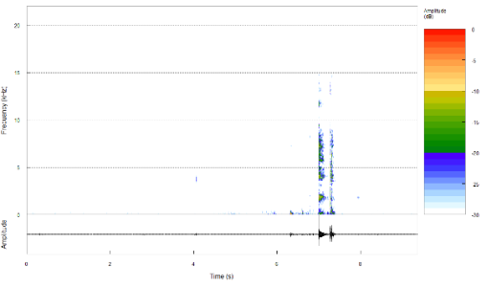
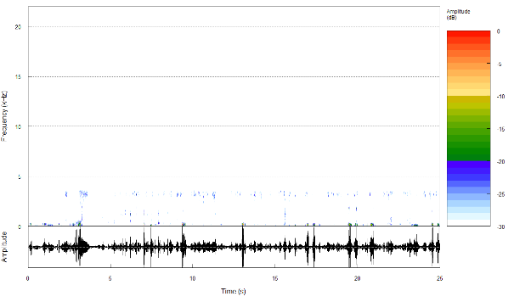
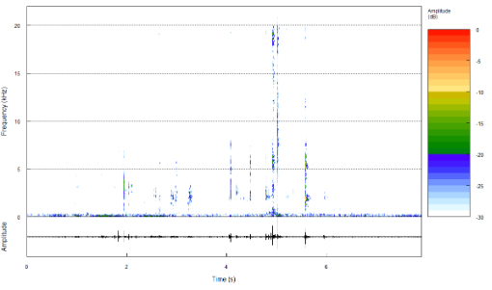
II. A. Creation of a new data set
Cathy, session 3, kibble A’
breaks
2 breaks observed
Cat1, session 9, kibble C
Moon, session 3, kibble A’
breaks
MARS DATA
NEW DATA
Notes:
Here you can see some of the new data compared to MARS data
All recordings here have 2 breaks, and we can see them on the new data, but not on mars data. But we can also see that the first recording is kind of the ideal recording, but due to the negative points I talked about just before, they are not all like that. You see it is not so clear on the second one.
But even with the new data the chews were still more complicated to discern, so we chose to focus first on the breaks, and labellized only the breaks in the samples.
comparaison New data et Ma
Comparaison spectro et courbes entre les deux jeu de données
Concentration sur les crocs

Slide 10
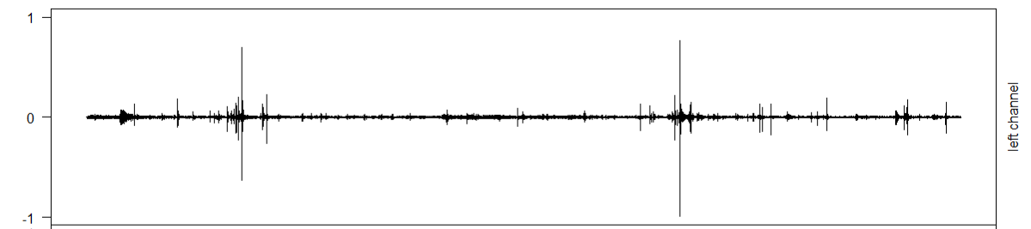
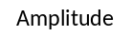

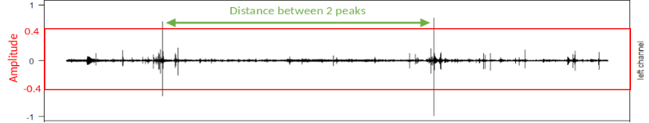
II. B. Amplitude - Method
Initial
Recordings
Normalised Recordings
Peak detection
Prediction
2 peaks
Notes:
Our first counting method is using only the amplitude of the signal. So we take the initial recordings, we normalize it, and then we use 2 thresholds : first we select points with an amplitude limit, so greater than 0.4 and smaller thans -0.4 for instance, and then we use a distance between 2 peaks limit to decide whereas selected points belong to the same peak or not. Thanks to that we can count the peaks.
Stratégie de prédiction

Slide 11
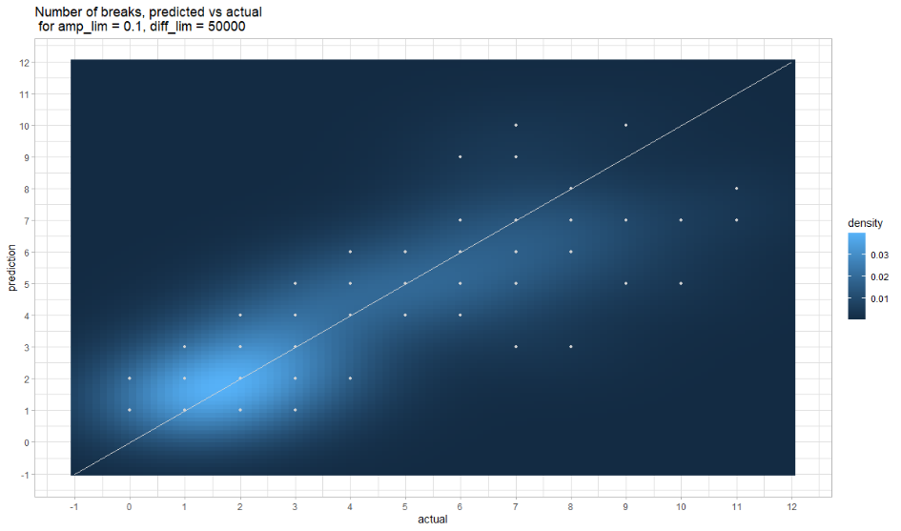
II. B. Amplitude - Results
MSE (Mean Square Error) = 2.52, the algorithm predicts the number of breaks with an accuracy of around 1.6 break
Notes:
This is a result obtained with this method. The graph presents the predicted values versus the actual values, which means that we want our points to be as close to the line (bisector) as possible. Since we predict integers a lot of points are superimposed, that’s why we also drew the density. So the result gives us an accuracy of around 1.6 break, which is not bad but we tried an other method to see if we could improve this result.
Stratégie de prédiction

Slide 12

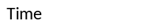
II. C. Machine Learning
Data Train
Initial
Recordings
2. Model Application
Machine Learning
Algorithm
Model from the Algorithm
1. Machine Training
Probability profile of being a break
Finale Prediction
Notes:
Stratégie de prédiction

Slide 13
II. C. Machine Learning
Data Train
Initial
Recordings
2. Model Application
Machine Learning
Algorithm
Model from the Algorithm
1. Machine Training
Probability profile of being a break
Finale Prediction
Notes:
Stratégie de prédiction

Slide 14
II. C. Machine Learning
Labelling
break
background noise
break
break
Collecting break and background noise
Break features data
Background Noise features Data
Supervised classification task Model
(Random Forest)
break
?
background noise
Notes:
Machine Learning
Création du jeu d’entrainement
Performance du modèle
Nos données ont été labellisées de telle sorte que on a les zones des enregistrement où un croc se produit.

Slide 15
II. C. Machine Learning
Data Train
Initial
Recordings
2. Model Application
Machine Learning
Algorithm
Model from the Algorithm
1. Machine Training
Probability profile of being a break
Finale Prediction
Notes:
Stratégie de prédiction

Slide 16
II. C. Machine Learning – Model application
Trim an initial recording into frames
Extract features from frames
Get the probability of being a break with the model
Probability to be a break
Notes:
Stratégie de prédiction

Slide 17
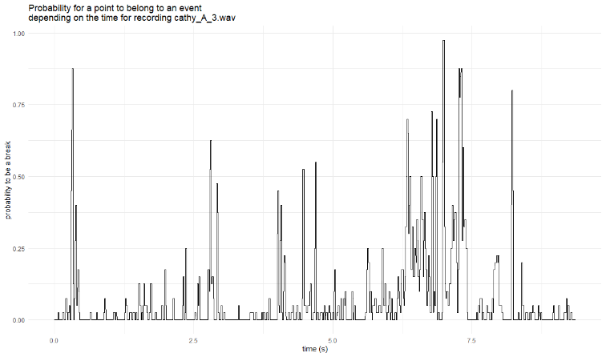
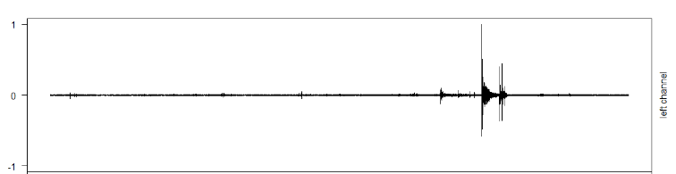
II. C. Machine Learning – Model application
Time Threshold
Probability Threshold
Probability of being a break throughout the recording vs amplitude of the recording -> not a clear correspondence
Notes:
As Audrey just mentioned, the use of the machine learning model gives us a vector of probability of being an event or not. You can see here the graph of the probability of belonging to an event (a break) for each point of the recording.
Then we apply quite the same method than with the amplitude, so we use a probability threshold to select points of interest, and then we use a time threshold, which is a distance between 2 peaks, to count the peaks.
The graph below is the corresponding amplitude of the signa, but as you can see the correspondence is not very clear. Therefore we don’t really expect marvelous results.
Stratégie de prédiction

Slide 18
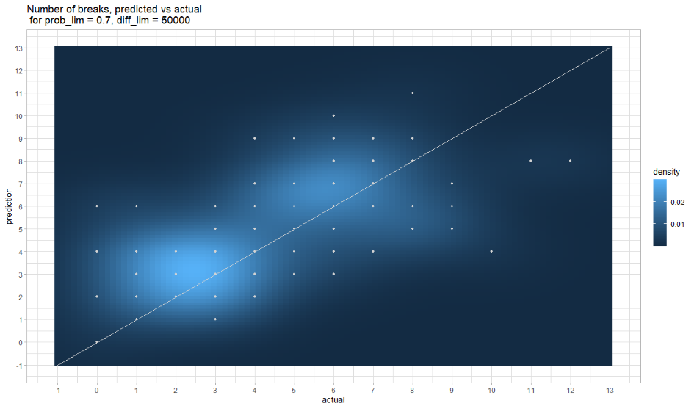
II. C. Machine Learning – Model application
Not very good prediction quality
Could be linked to the difference between the data to train/test the model and the frames from the original recordings
MSE (Mean Square Error) = 5.01, the algorithm predicts the number of breaks with an accuracy of around 2.2 breaks
Notes:
So these are the results, the accuracy is smaller than with the amplitude method since it predicts with more or less 2.2 breaks. But this performance is maybe linked to the difference between the data we use to train and test the model, and the data we use to predict.
Stratégie de prédiction

Slide 19
Improvements & Leads
Unavoidable background noises
Recordings
Frame with undetermined noise
Prediction
Amplitude selection
Machine Learning Model trained to differentiate noises from breaks
Note : Machine learning approach can differentiate bites and breaks

Slide 20
Conclusion
About Data acquisition method
Noise is a limiting factor for prediction. It must be kept to a minimum
Strong labelling allows more technical possibilities that can be used for prediction.
About acoustic data for detection of events
Break produce a quite identifiable sound. Bites could be more difficult.
Notes:
On a pu montrer qu’aujourd’hui les données ne permet pas une exploitation des données en vue d’un travail statistique
Crocs sont facilement détectable pour la mastication ce sera une tâche plus sensible

Slide 21
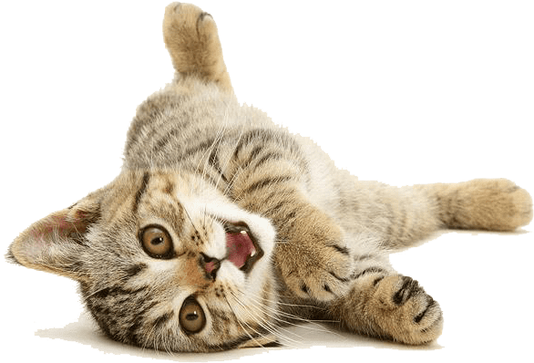
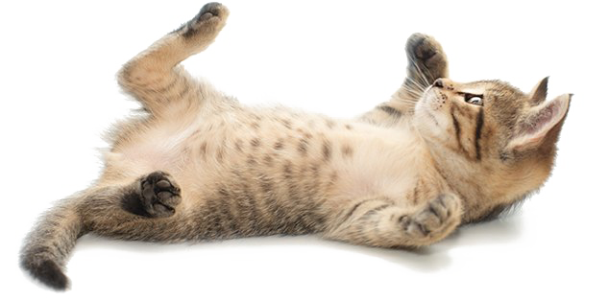
THANK YOU
Image sources : pngarts.com and Verlina
Notes:
Merci de votre attention
Source des images
Et remerciements

Slide 22
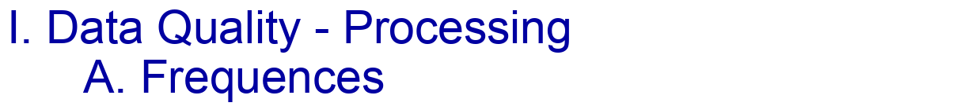
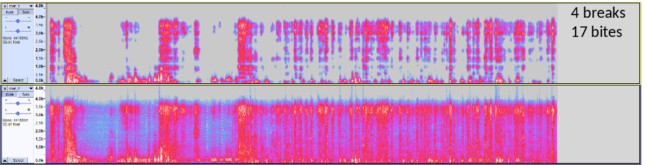


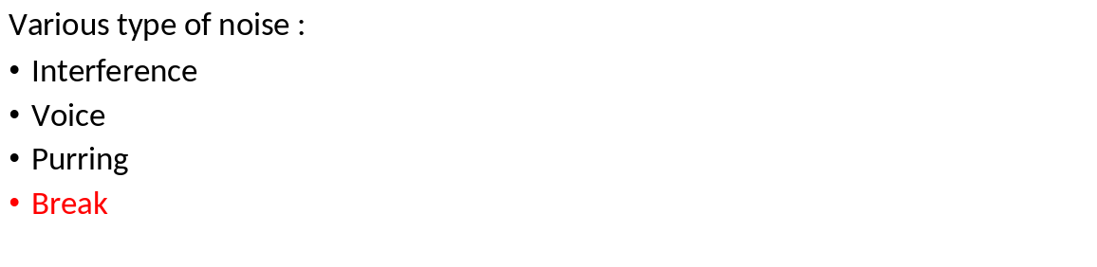
Notes:
ICA :
Idée : méthode de détection des sources
Problème : Il faut plusieurs enregistrement d’un même moment (ne s’applique à notre protocole) . Bien expliquer que le son doit provenir de plusieurs sources (chat = source, voix = source …)
AV

Slide 23
I. Data Quality – Processing B. ICA
Independent Component Analysis
(method of blind source separation)
IDEA : try this method to isolate the different independent sources, to separate the sound of interest (cat breaking and chewing) from the rest. Would like to separate the following sources :
- cat
- human (voices)
- electronic machines (interferences)
BUT : need simultaneous recordings, thus multiple microphone
Notes:
ICA :
Idée : méthode de détection des sources
Problème : Il faut plusieurs enregistrement d’un même moment (ne s’applique à notre protocole) . Bien expliquer que le son doit provenir de plusieurs sources (chat = source, voix = source …)
AV

Slide 24
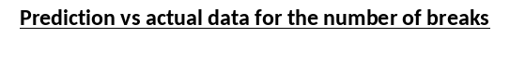
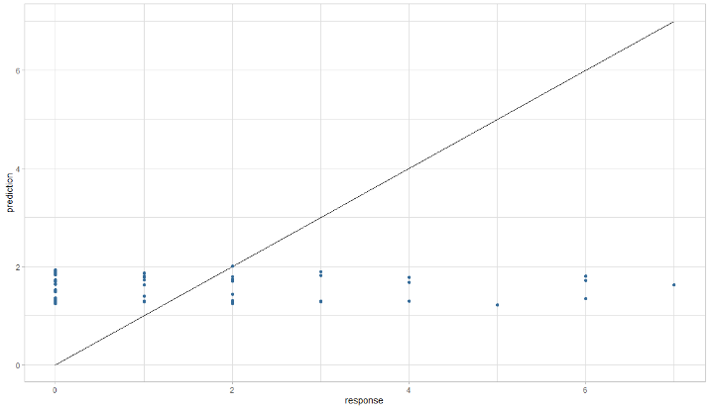
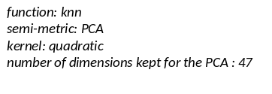
I. Data Quality C. Functional data analysis
IDEA : use the amplitude curves as explanatory variables (1 point = 1 variable) to predict the quantitative response variables (number of breaks and bites)
Different methods to analyse the data, and different parameters to fix
BUT : A response variable doesn’t implicate a special move of the curve at a special point
Notes:
Analyse fonctionnelle :
Idée : Courbes d’amplitude sont considéré comme des fonctions, extraction d’une variable réponse quanti à partir d’une courbe
WHAT : results for one of the methods in predicting number of breaks :
not working, model predicts between 1 and 2 no matter what the actual number of breaks is
Same kind of results for all the methods and parameters
Problème : Très mauvaise prédiction : une variable réponse n’implique pas une forme de courbe

Slide 25
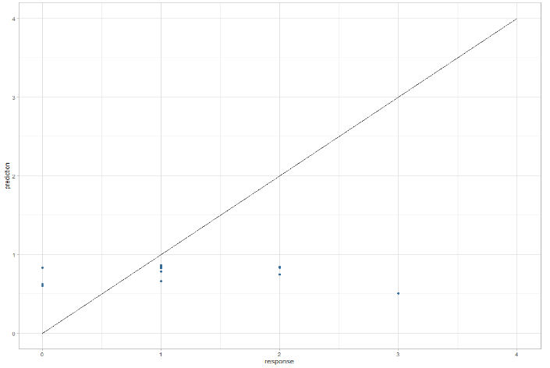
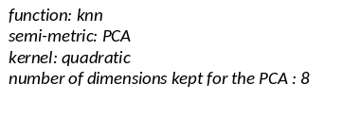
II. Counting events B. Labelling
IDEA : use the amplitude curves as explanatory variables (1 point = 1 variable) to predict the quantitative response variables (number of breaks and bites)
Different methods to analyse the data, and different parameters to fix
BUT : A response variable doesn’t implicate a special move of the curve at a special point
Notes:
Labelisation faible ou forte ?
Test : Est-ce que une labellisation faible (moins couteuse) suffit ?
Résultats de l’analyse fonctionnelle
Conclusion : labélisation forte
AV

Slide 26
II. Counting events C. Break detection methodology
Predicted as Background noise
Contentious prediction
Predicted as break
= Frame described by features
Notes:
Machine Learning
Création du jeu d’entrainement
Performance du modèle
Nos données ont été labellisées de telle sorte que on a les zones des enregistrement où un croc se produit.

Slide 27
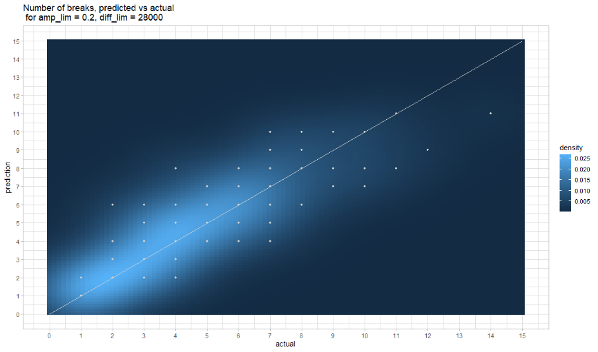
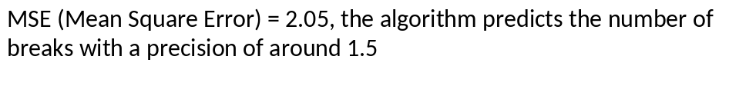
II. Counting events C. Break detection methodology – manual method
Problem : can’t predict correctly recordings without any break
Notes:
Règle de décision
AV

Slide 28
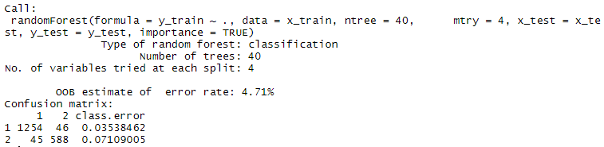
II. Counting events C. Break detection methodology - application of the random forest model
Notes:
Résultats globaux
Les jolies graphiques
AV

Slide 29
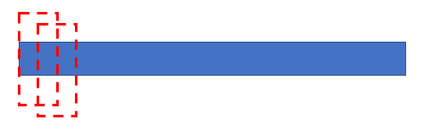
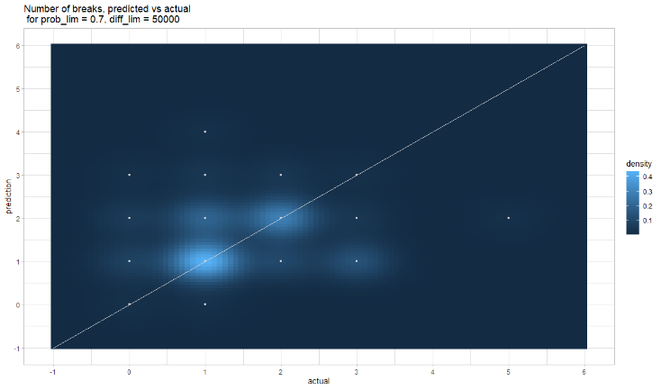
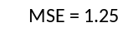
II. Counting events C. Break detection methodology - application of the random forest model
Going through the entire sample through frames, and using the random forest model to predict the probability for the fram of being an event or not
Then finding an optimal probability limit (probability of being an event) and distance between 2 peaks to count the total number of peaks
Notes:
Résultats globaux
Les jolies graphiques
AV

Slide 30
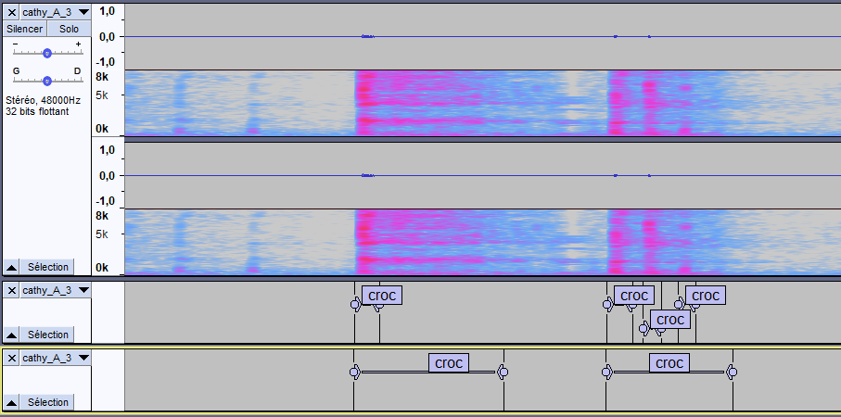
Notes:
Merci de votre attention
Source des images
Et remerciements

